Slide 1
A Major Project on Gym Management System Prepared By:- Debojit Gogoi Roll No-16 Guide-Rajiv Kalita

Slide 2
Gym Management System
Introduction : Our Gym Management Software is a gym and health club membership management system .You can keep records on your members their memberships, and have quick and easy communication between you and your members . Gym Management also includes a booking system , point of sale and has a range of reports that help in the management of your club. Our Gym Management System provides lots of function such data entry of customer , keeping record of all the things about customers fees , plan , physical fitness which help to provide good quality of services to customer from Gym managers . In this proposed system also provide the total information about machinery and data of coaches is also stored in it . Services provided by Gym also handled by this system . This system structure is become very simple to understand because of data flow diagram provided by us .

Slide 3
Objectives of the Gym Management System
1) The main objective of the project is to develop software that facilitates the data storage , data maintenance and its retrieval for the gym in an igneous way .
2) To store the record of the customers , the staff that has the privileges to access , modify and delete any record and finally the service , gym provides to its customers .
3) Also , only the staff has the privilege to access any database and make the required changes , if necessary .
4) To develop easy to use software which handles the customer-staff relationship in a effective manner .
5) To develop a user friendly system that requires minimal user training . Most of features and function are similar to those on any windows platform .

Slide 4
Hardware & Software Requirement
Hardware Requirement:
Processor : Pentium IV 2GHz and Above
RAM : 1GB RAM
Monitor : 15” Color Monitor
Keyboard
Mouse
Software Requirement:
Operating System. : Windows
Developing Tool : PHP, HTML, CSS, Java script
Database : MYSQL

Slide 5
DFD

Slide 6
Context Level DFD

Slide 7
Level-1 DFD

Slide 8
Level-2 DFD

Slide 9
ER-Diagram

Slide 10
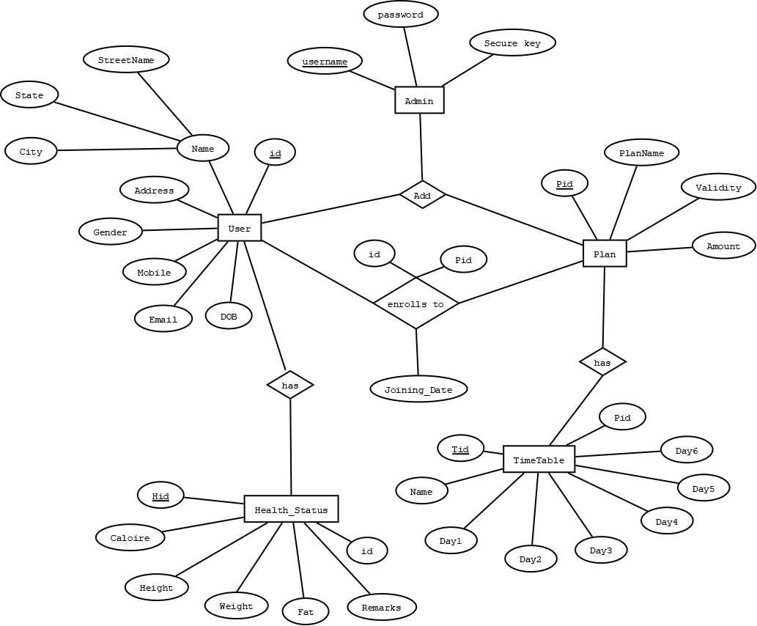
ER diagram

Slide 11
Relational
Diagram

Slide 12
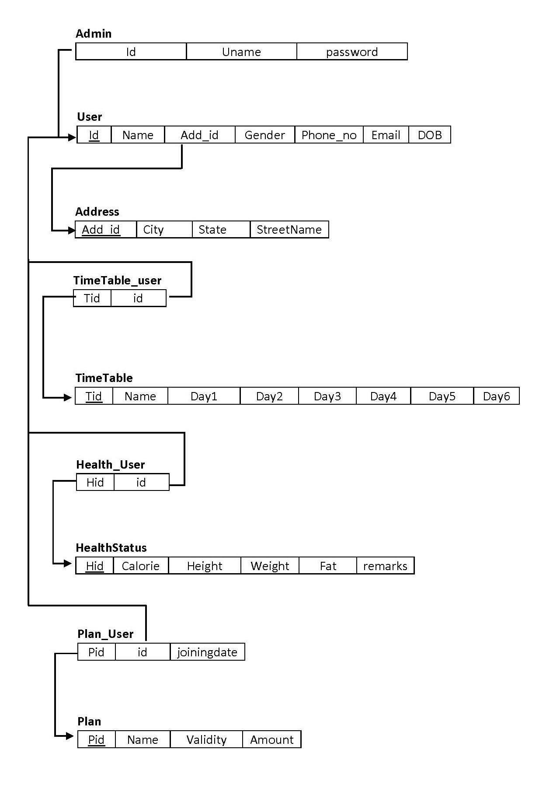

Slide 13
Thank You

